Slide 1
Sumo Robotics
Team Members:
Saud Alabhoul, Jasim Albenali, Mohammad Albaghli, Abdulaziz Kandari Rashid Alfadhli

Slide 2
Description: Sumorobot 3kg (R/C)
Two Sumorobots challenge in a head-to-head match. With following the rules of sumo matches
Class | Height | Width | Length | Weigh
Mega Sumo - R/C | unlimited | 20.0 cm | 20.0 cm | 3,000 g
Table 1: Measurements
Specification:-
R/C Controlled Sumo robot
Qualified of following the competition “Rules”
Following (Width/Length/Weigh) limitations

Slide 3


Sponsorship of the project & Client
-Our Sponsor of the Sumorobot competition will be Northern Arizona University.
-Team 18F06 will prove to accomplish all necessary requirement of the sumo bot competition as undergraduates of ME students.
Figure 1: NAU Logo
-The client will be the ROBOGAMES Competition.
Figure 2: ROBOGAMES Logo

Slide 4
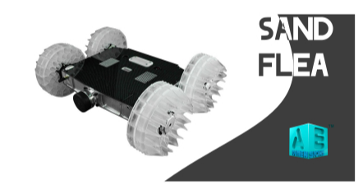
Newest Generation Sumobot
“SandFlea” created by Boston dynamics
Specifications:-
Battery & Propane powerd
Weigh: 5kg, Height: 15cm, Joints: 5
Capabilities:-
Jumps 10m
25 Bounces per charge
Figure 3: Sand Flea

Slide 5
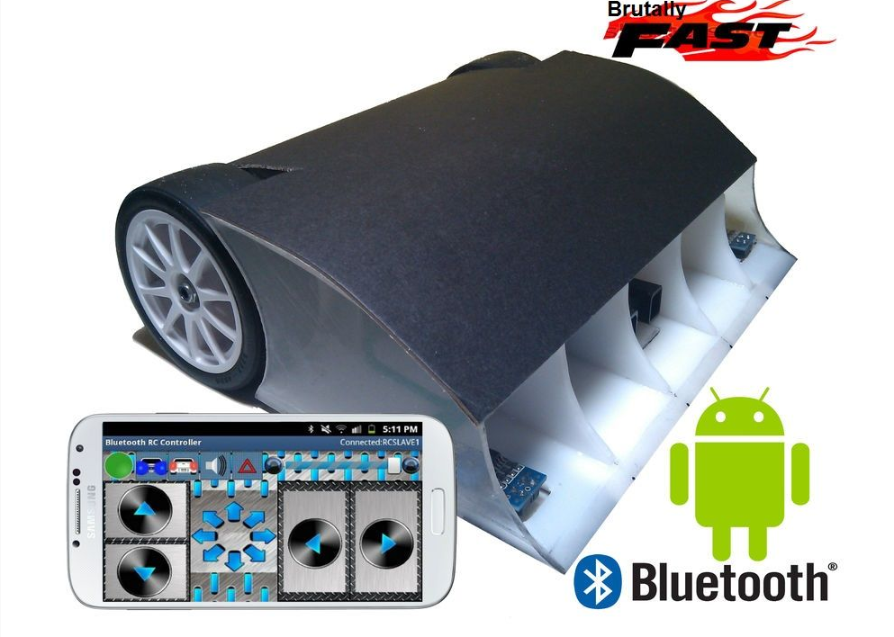
Other similar low-budget sumobot
Low-cost 90$
Bluetooth controlled Sumobot
Competition ready
Figure 4: Android sumobot

Slide 6
Design Requirements
Short charging time with long battery life.
Lasts 3 rounds each round is 3 minutes.
R/C robot that does not have sticky substances
c. Artbot prepared and Creative Design.
No hazardous & dangerous material
e. The controller does not exceed 75Mhz.

Slide 7
Customer Requirements
1. R/C Robot | Weight
Weigh | 5
Durability | 3
III. Portable | 4
IV. Simplicity | 2.5
V. Pausing Capabilities | 3
VII. RC Controlled | 5
VIII. Safety | 4
Table 2:- Measurements

Slide 8
Engineering Requirements.
Engineering Requirements
Maintenance
Remote Controlled
Autonomous
Torque
Consistency
Cost
Minimizing Weight
Size
Power Source
Motor
Table 4: ENG Requirements.

Slide 9
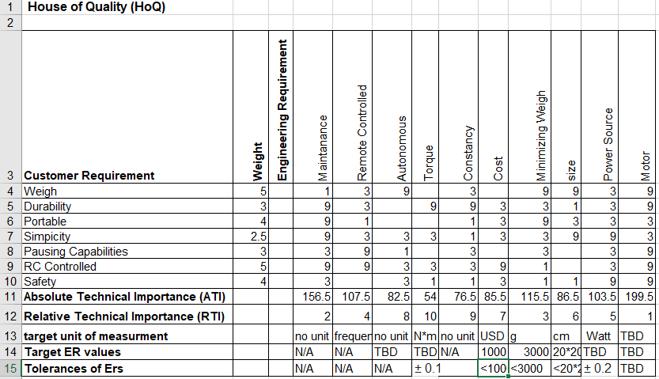
House of Quality
Table 4: HoQ.

Slide 10
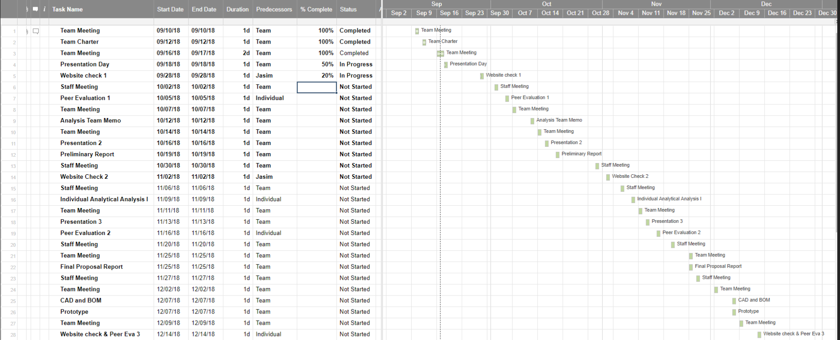
Gantt Chart

Slide 11

Budget
No Specific Budget
Ranges between 1000~2000
Recycling many parts of previous projects
Figure 5: Budget Plan

Slide 12
Questions?

Slide 13
References
https://www.instructables.com/id/Android-Controlled-Bluetooth-Sumobot-Ultimate-DIY-/
http://blog.aedimensions.com/sand-flea-the-jumping-robot/
https://www.bostondynamics.com/sandflea
http://robogames.net/index.php

